Slide 1

McGraw-Hill Technology Education
Copyright © 2006 by The McGraw-Hill Companies, Inc. All rights reserved.

Slide 2
Chapter 2A
The Internet and the World Wide Web

Slide 3
The Internet’s History
1969 – ARPANET
  Developed by the Department of Defense
  Connected universities and defense bases
1973 – ARPANET connects to Europe

Slide 4
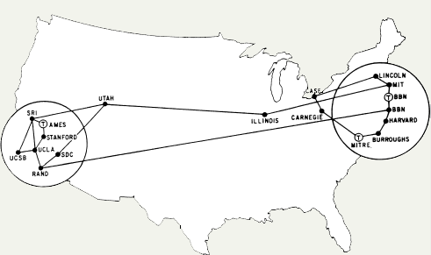
ARPANET 1973

Slide 5
The Internet’s History
Mid-1980s – NSFNet
  Network between supercomputers
  Internet was the link to ARPANET
  No commercial traffic allowed
1990s
  ARPANET shut down
  NSFNet abandoned
  Commercial networks take over
Notes:
Discussion point
Have students discuss the pros and cons of no central control for the Internet. Some discussion points can include copyright issues, free speech, advertisements and information access to all.

Slide 6
Today and the Future
100,000 new web sites per month
More than 50% of U.S. households online
Access is available throughout the U.S.
Eventually access will be global

Slide 7
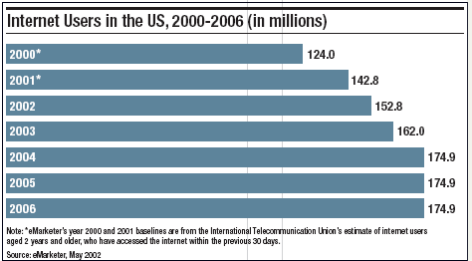
U.S. Internet Growth

Slide 8
The Internet’s Major Services
The World Wide Web (WWW)
  Developed in 1993 by Tim-Berners Lee
  Allowed connection of documents
  Required a browser to read documents
Electronic mail (e-mail)
  Instantaneous transmission of documents

Slide 9
The Internet’s Major Services
News
  Often called newsgroups
  Electronic discussions on several topics
File Transfer Protocol (FTP)
  Sends and receives files
Notes:
Teaching tip
Show a typical news group to the students in class. Be sure that you have connected and downloaded all posts before trying the demonstration.
Demonstrate the use of ftp to change a web site.

Slide 10
The Internet’s Major Services
Chat
  Public real time conversation
Instant messaging
  Private real time conversation
Peer-to-peer services
  Allows sharing of files among users
  Napster and Kazaa are examples
  Illegal to share copyrighted material
Notes:
Discussion point
Recently the pop artist Madonna posted several copies of her songs on Kazaa and other file sharing services. Instead of music, she talked at length about copyright infringement through music sharing. In retaliation, hackers hit her website and temporarily made her songs free to purchase. Who is right?

Slide 11
Accessing The Internet
Internet Service Provider (ISP)
  Company that provides Internet access
Dialup
  Connects to Internet through phone line
  Modem connects to the phone line
  Slow connection

Slide 12
Accessing The Internet
High-speed access
  Connect through a special line
  2 – 25 times faster than dialup
  DSL, Cable, T1 are common

Slide 13
Understanding the Internet
The Internet allows accessing resources
The Web simplifies the Internet
The Web connects documents
  Hypertext creates links between documents
  Documents are stored on a web server
  HTTP delivers documents
Notes:
Teaching tip
Find out who has a web presence. If the site is appropriate, display it in class. Have the student discuss what is needed to establish and maintain a web presence.

Slide 14
Understanding the Internet
Web site is a collection of documents
  Document is a web page
  Pages are published to the web
Hypertext Markup Language
  Creates web pages
  Describes how pages should look
  Content enclosed in tags
  <tag>content</tag>
Notes:
Teaching tip
Show your students how to access the HTML of an appropriate web site.

Slide 15
Understanding The Internet
Browsers
  Read and translate the HTML
  Display web content
Uniform Resource Locator (URL)
  Address of a web page
Notes:
Teaching Tip
Dissect the URL provided.

Slide 16
Understanding The Internet
Helper applications
  Plug-ins
  Enhance a browser’s functionality
Streaming audio and video
  Sends the file in small chunks
  Chunks downloaded while others play
Notes:
Teaching point
Direct the students to several different streaming video sites. Www.launch.com and www.apple.com/QuickTime are two excellent examples. Be sure your classroom browsers have the appropriate plug-ins.

Slide 17
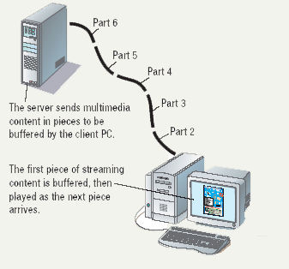
Streaming Audio

Slide 18
Using a Browser And The WWW
Browser starts on the home page
Navigating the web
  Enter a URL in the browser
  Click a link
  Links are typically blue underlined words
  Image maps are picture links
When finished, close the browser

Slide 19
Searching the Web
The Web is unorganized
Directories
  Categorize the Internet
Search engines
  Find sites by keyword
Notes:
Insider information
The search engine www.google.com has become one of the hottest search engines on the planet. It is so popular, it’s name has become a verb. For example, “I googled the answer last night” is a phrase uttered on college campuses the world over.

Slide 20
Searching the Web
Site searches
  Large sites have an internal search
Metasearch sites
  Search several web sites at once
Sponsored links
  Sites pay for better search results

Slide 21
Search Techniques
Quote the exact phrase
Use the keyword AND
Use the keyword NEAR
Avoid common words
Use the site’s advanced tools

Slide 22
Chapter 2A
End of Chapter

